Slide 1
Econ 100 Principles of Economics Serda Selin Öztürk
Lecture 1
February 27

Slide 2
Lecture plan
Syllabus
Book. Lecture Notes. Study tips. Exams. Grading. Make ups.
My course (and book) recommendations
After Econ100: Econ201 and Econ202
A very short case study: What would you do, if you were …

Slide 3
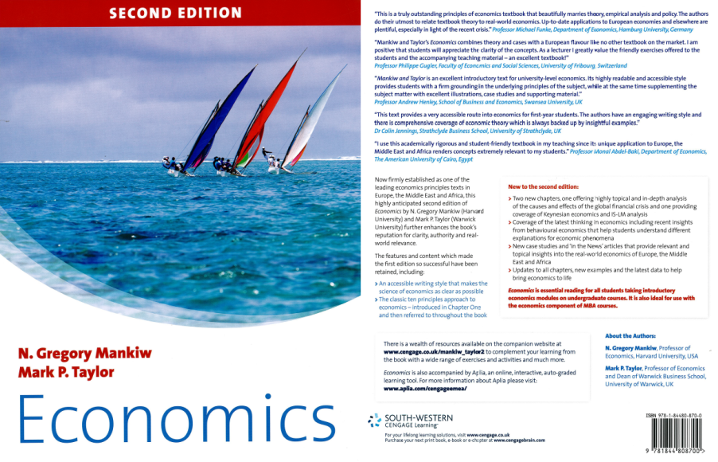
The book
Economics, 2e.
Gregory Mankiw & Mark Taylor
928 pages, 28x22.3cm
Shipping Weight: 4.1 pounds
Book website: http://cws.cengage.co.uk/mankiw_taylor2/students/stu_title.htm

Slide 4
A common question
Do we have to buy the book? No.

Slide 5
Another common question
Professor:
Could you give me consent?
Please give me consent.
You should give me consent.
Give me consent.
Please let me in.
Let me in.

Slide 6
Grading
One midterm exam, one final exam and assignments.
Assignments weekly starting from next week. You will solve them online.
Midterm exam: week 8 (+2/-1 week)
Final exam: during finals period
both scheduled by the Registrar’s Office.
MAKE UP exams:
not more difficult than regular exams
must have a valid excuse.

Slide 7
Grading: MAKE UP exams
If you are going to miss an exam you must
(1) send me an email before the exam explaining why you cannot attend the exam
A make-up exam will be given (within one week after the midterm date) only in case of properly documented cases, such as a medical report from the KU health center.
If you do not follow these instructions, you will receive a 0 for the exam that you missed EVEN IF YOU HAVE A WELL DOCUMENTED LEGITONATE EXCUSE.

Slide 8
How is your letter grade computed?
35% Midterm Exam.
45% Final Exam.
20% Assignments. Worst two assignment grades will not be counted.

Slide 9
It is not true that “everybody gets an A in Econ 100”.
This is an actual quote from a student (who received a D+)
To pass you need 50.
For an “A” you need at least 90.

Slide 10
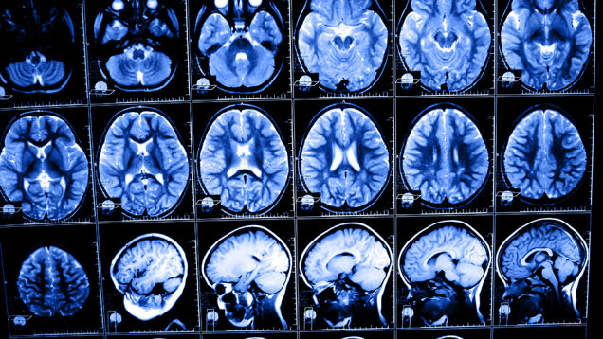
Digital Dementia: Your Smart Phone Is Giving You Brain Damage

Slide 11
Enough about grades

Slide 12
https://ku.blackboard.com
syllabus
lecture notes (posted after class)
assignments
past exams + answers (1 week before the exams)
information: exam date topics, classroom
information about office hours, the TA’s office hours
readings

Slide 13
Lecture Notes.
Fairly detailed, regularly updated. But no substitute for lectures
Study tips.
Solve the past exams (to be posted 1 week before exams)
Do the assignments: very important,
Go over lecture notes,
Go to Econ 100 KOLT tutors office hours
Come to my office hours. (send me an email a day before to set up an appointment)
Read the book.

Slide 14
Exams (very similar to past exams)
Multiple choice questions + a few short answer questions- simple math calculations. No essays.
Exams are not difficult!

Slide 15
After Econ100
Econ201 Microeconomics
Studies the behavior of individual units (consumers and firms); the demand and supply of individual goods and services.
More abstract/mathematical than Econ202
But it is a must if you want to learn economics
Highly recommended for BA majors!

Slide 16
After Econ100
Econ202 Macroeconomics
Studies aggregated indicators such as GDP, unemployment, and inflation, tries to understand how the whole economy functions.
Always in the news, and on TV: economic growth, exports, imports, central bank. Interest rate, current account deficit, inflation, exchange rates, etc.

Slide 17

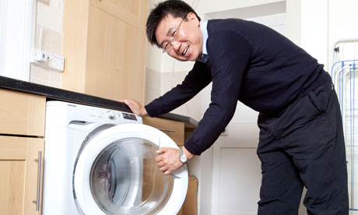
Book recommendations

Slide 18
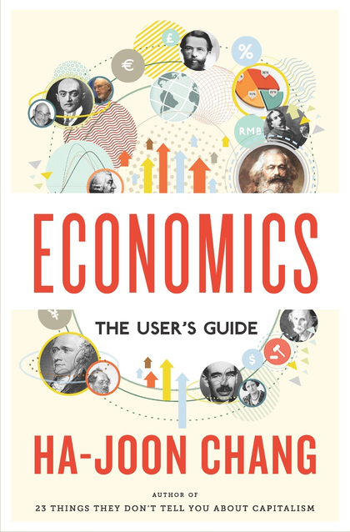
Economics:
The User's Guide:
A Pelican Introduction
Pelican Books 2014

Slide 19
Econ 100: Goals and objectives
Econ100 is one of the very few courses that everyone must take (almost no alternative)
I think we can turn this into pleasure and
Be happy
School means leisure, discussion (from Greek schole)
Learn some economics
Get good grades

Slide 20
Now…
A 2 minutes lecture on
“What is economics?”

Slide 21
Economics is about economy?
95 percent of economics is common sense?
made to look difficult, with the use of jargons and mathematics
Definition: Economics is the study (or science?) of allocation of scarce resources.
It is about individual behavior and mainly about rational behavior. What does rational mean? A highly loaded and controversial concept.

Slide 22
A very short case study

Slide 23
You are the general manager of IL JK company.
The company provides extermination services (böcek ilaçlama).
There are some administrative personnel who cannot be fired
and …
196 workers who do the actual extermination work and can be fired.

Slide 24
More information…
The company started 5 years ago.
It is owned by three families.
The work requires only a low level of skills so that each worker requires only one week of training.
Almost all workers have been with the company for 3 to 5 years.
The company pays its workers more than the minimum wage. The workers’ wages, including overtime, are between 9,500TL and 10,200TL per month.
The minimum wage is about 8500 TL.
The company gives its workers all the benefits required by law.

Slide 25
Current situation
Until recently, the company was very profitable.
As a result of the continuing recession, however, there has been a big decrease in profits though the company is making profits.

Slide 26
The big decision
You will soon have a meeting with the owners and your management team must decide how many workers to lay off.
IL JK’s Finance Department has prepared the following forecast of annual profits:

Slide 27
Data
Number of workers who will continue to be employed | Expected annual proﬁt in TL, millions
0 (all the workers will be laid off) | Loss of 8
50 (146 workers will be laid off) | Profit of 1
65 (131 workers will be laid off) | Profit of 1.5
100 (96 workers will be laid off) | Profit of 2
144 (52 workers will be laid off) | Profit of 1.6
170 (26 workers will be laid off) | Profit of 1
196 (no layoffs) | Profit of 0.4

Slide 28
Your recommendation?
Send me your recommendations by email till tonight 8 pm.
I will show you the results on Wednesday in lecture time

Slide 29
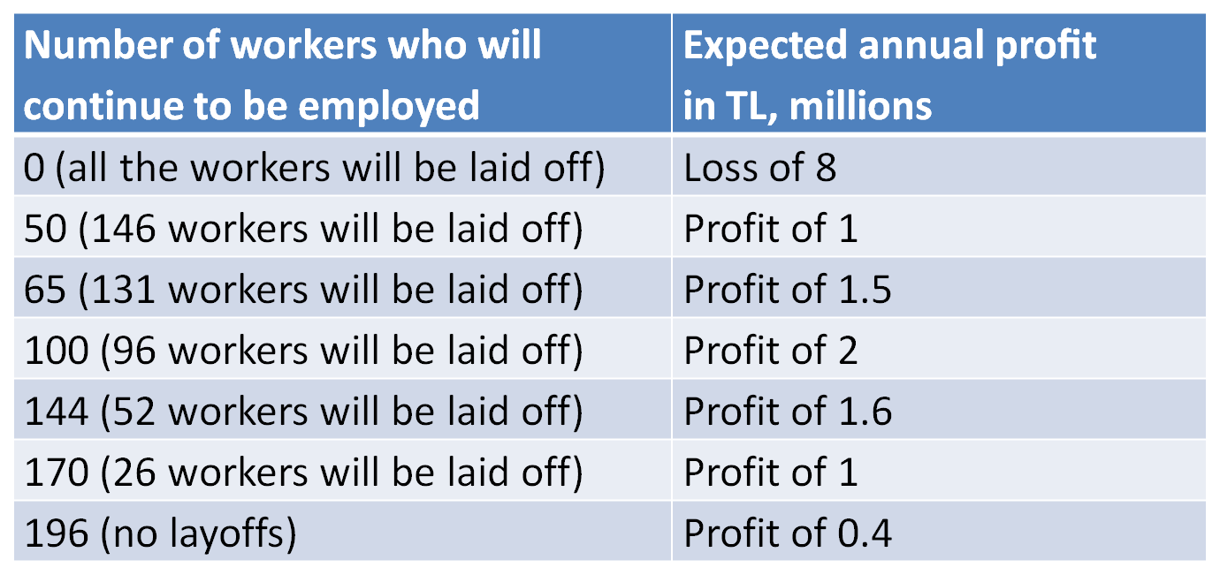
Your recommendation:
I recommend continuing to employ ______ of the 196 workers in the company.
Why? A brief justification for you decision: ________________
___________________________________________________

Slide 30
End of the lecture

